Slide 1
Connective Tissue Diseases
Dr. Shaluka Jayamanne

Slide 2
Introduction
Autoimmune diseases
knowledge of immune system
Difficult to diagnose
  nonspecific symptoms
  tend to overlap
common histiologic feature
  inflammatory damage CT and blood vessels
  fibrinoid material deposition

Slide 3
Immune System
lymphoid stem cell
B-cell
T-cell
macrophage or monocyte
NK cells

Slide 4
Connective Tissue Diseases
abnormal interaction
three theories
  sequestered antigen
  exogenous antigen
  altered antigen

Slide 5
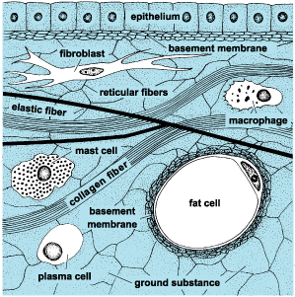


Slide 6
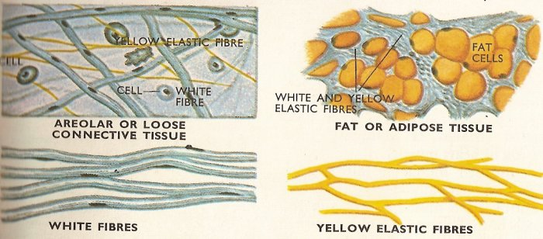

Slide 7
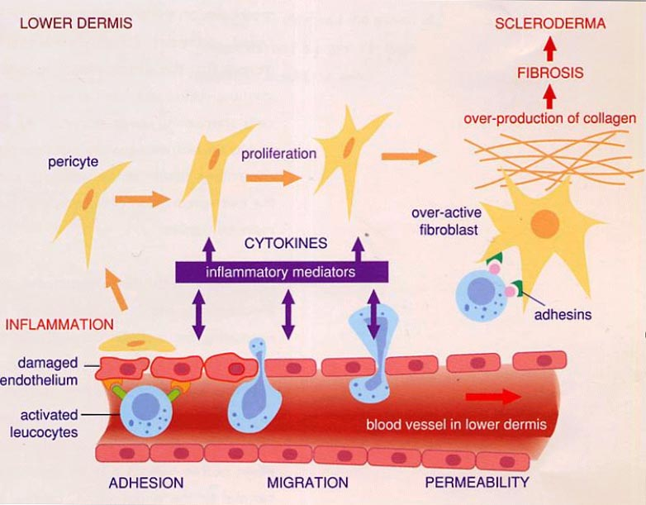

Slide 8
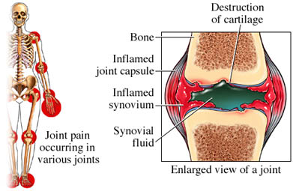

Slide 9
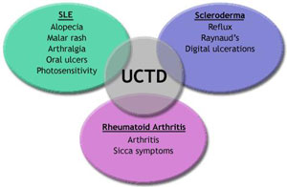
MCTD

Slide 10
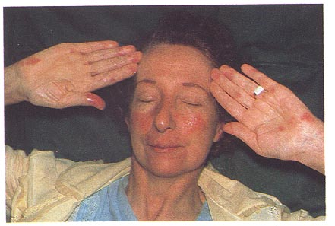
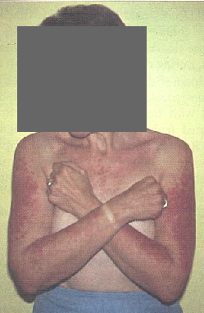
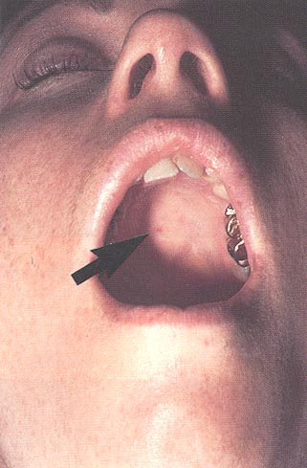
SLE

Slide 11
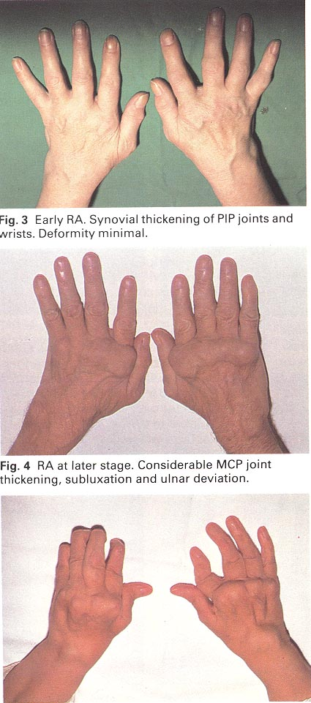
Rheumatoid Arthritis
General
  synovial tissue involvement

Slide 12
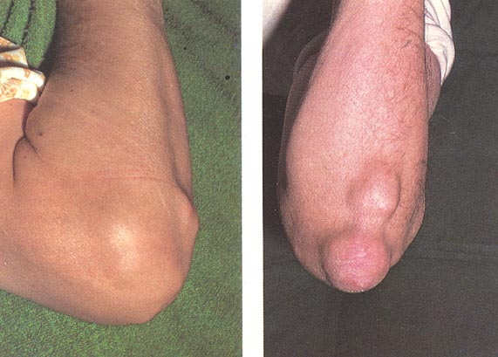
RA

Slide 13
Sjogren’s Syndrome
General
  immune mediated
  destruction of exocrine glands
  primary
    sicca syndrome- isolated d/o lacrimal and salivary glands
  secondary
    sicca complex- assoc. with other CTD

Slide 14
Sjogren’s Syndrome
General
  prevalence
    1% population
    10-15% of RA patients
    9 to 1 F>M
    onset 40-60 yrs
  increased risk of lymphoma
    pehaps 44 times risk

Slide 15
Sjogren’s Syndrome
General
  clinical manifestations
    xerophthalmia, keratoconjunctivitis
    xerostomia
    other areas
      skin, vagina, genitalia, chronic bronchitis, GI tract, renal tubules
  diagnosis
    minor salivary gland biopsy
    labs
      RF and ANA
      SS-A/Ro 60%
      SS-B/La 30%

Slide 16
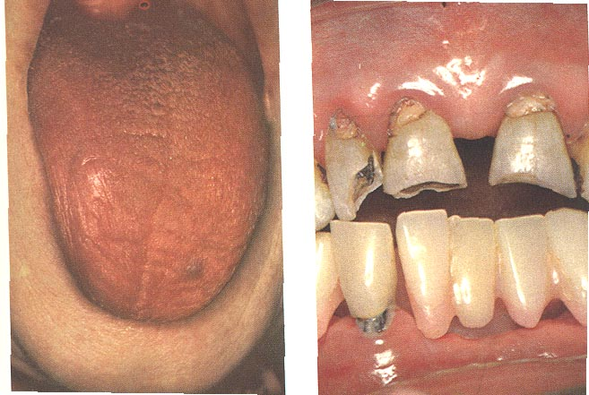
Sjogren’s Syndrome
Head and Neck Manifestations
  80% c/o xerostomia, most prominent symptom
  difficulty chewing, dysphagia, taste changes, fissures of tongue and lips, increased dental caries, oral candidiasis

Slide 17
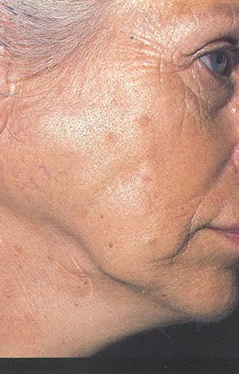
Sjogren’s Syndrome
  salivary gland enlargement

Slide 18
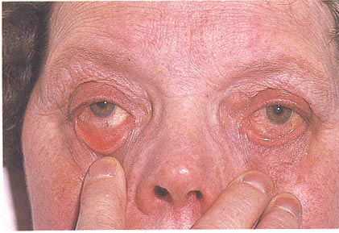
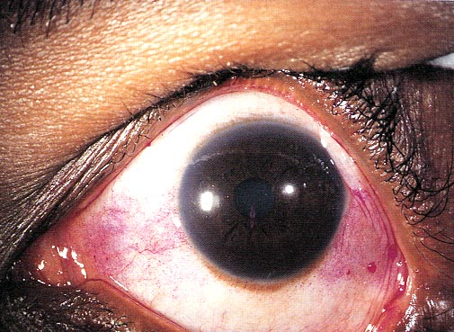
Sjogren’s Syndrome
  eye complaints
    dryness, burning, itching, foreign body sensation
  keratoconjunctivitis sicca
    corneal abrasions - rose bengal staining

Slide 19
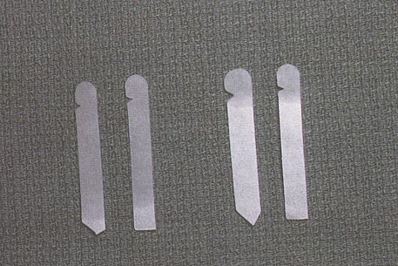
Sjogren’s Syndrome
  Schirmer I
  Schirmer II
  nasal crusting, epistaxis, hyposmia

Slide 20
Sjogren’s Syndrome
Treatment
  symptomatic
    oral fluid intake
    saliva substitutes
    artificial tears
  avoid
    decongestants
    antihistamines
    diuretics
    anticholinergic

Slide 21
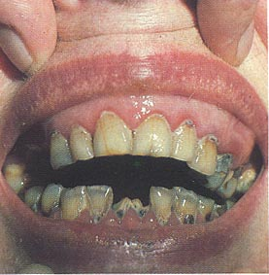
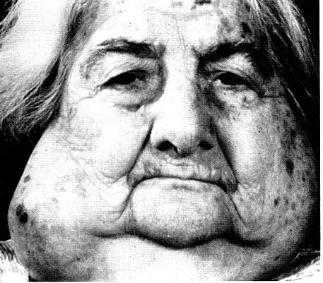
Sjogren’s Syndrome
Treatment
  close dental supervision
  surveillance for malignancy

Slide 22
Scleroderma
General
  increased depostion collagen in interstitium of small arteries and connective tissue
  sclerotic skin changes, often multisystem disease
  prevalence
    3-4 to 1 F>M
    30-50 yrs

Slide 23
Scleroderma
General
  presentation
    Raynaud’s phenomenon
    edema fingers and hands
    skin thickening
  visceral manifestations
    GI tract, lung, kidneys, thyroid
  arthralgias and muscle weakness often

Slide 24
Scleroderma
General
  four categories
    diffuse cutaneous
      worse prognosis
    limited cutaneous
      more benign, less renal
    sine scleroderma
      visceral manifestations without skin changes
    systemic sclerosis in overlap

Slide 25
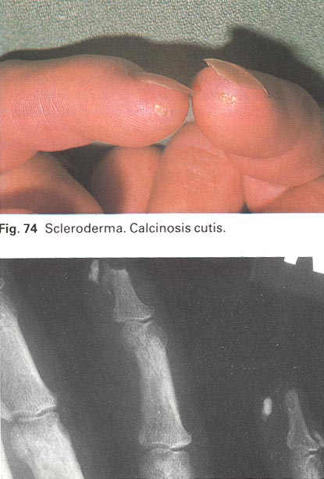
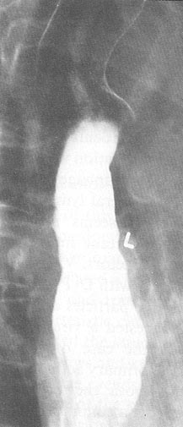
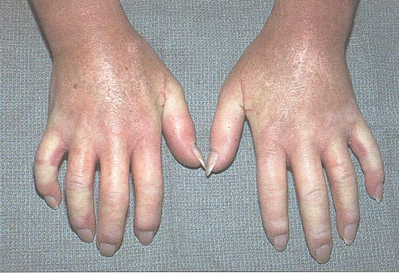
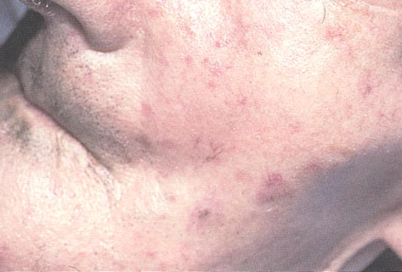
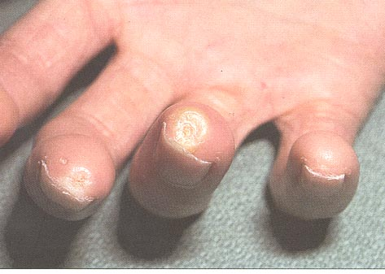
Scleroderma

Slide 26
Scleroderma
General
  labs
    diffuse cutaneous- anti-ScL-70
    limited cutaneous- anticentromere
    ESR, anemia, ANA

Slide 27
Scleroderma
Head and Neck Manifestations
  dysphagia
    most common initial complaint
    80% distal 2/3 pathology on BS
    decrease/absent paristalsis, dilation, hiatal hernia

Slide 28
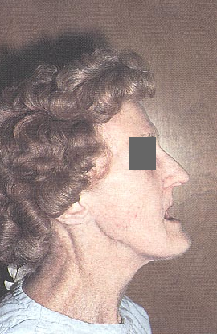
Scleroderma
  decreased mouth opening
    initial complaint 19%

Slide 29
Scleroderma
Treatment
  symptomatic
    calcium channel blockers in Raynaud’s
    H2 blockers for reflux
    NSAIDS and steroids for arthralgias and myalgias
    hand rehab

Slide 30
Polymyositis/Dermatomyositis
General
  group of disorders
  proximal muscle weakness
  nonsuppurative inflammation skeletal muscle
  prevalence
    2 to 1 F>M
    40-60 yrs

Slide 31
Myositis
General
  criteria
    proximal muscle weakness
    elevated serum CPK
    myopathic changes on EMG
    muscle biopsy inflammation
    dermatomyositis skin rash with above

Slide 32
Myositis
General
  labs
    Anti RNA synthetases
  up to 20% associated with malignancy

Slide 33
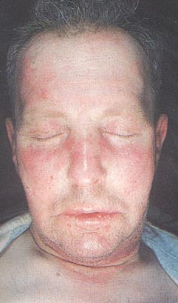
  skin lesions
    predilection for eyelids, nose, and cheeks

Slide 34
Plymyositis
Treatment
  steroids if symptomatic
  methotrexate, immunosuppresives nonresponders

Slide 35
Relapsing Polychondritis
General
  recurring inflammation cartilaginous structures
  eventual fibrosis
  prevalence
    F>M
    25-45
    can affect any cartilagenous structure
    including heart valves and large arteries

Slide 36
Polychondritis
General
  labs
    ESR
  histology

Slide 37
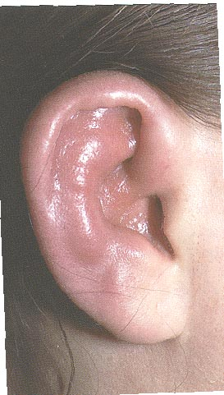
Polychondritis
  auricular chondritis, nonerosive arthritis most common

Slide 38
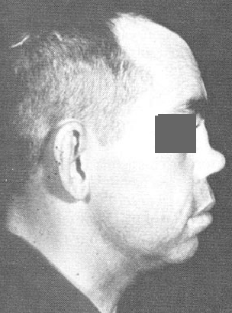
Polychondritis
  nasal chondritis

Slide 39
Polychondritis
  layngeal involvemen
    hoarseness
    stridor

Slide 40
Relapsing Polychondritis
Treatment
  salicylates, ibuprofen-symptomatic relief
  steroids for life threatening
  dapson

Slide 41
Mixed Connective Tissue Disease
General
  coexisting features
    SLE,scleroderma, polymyositis
  high titers anti- RNP
  prevalence
    unknown
    80% female
    30-60 years

Slide 42
MCTD
General
  diagnostic criteria
    elevated anti RNP plus
    three of either
      hand edema
      synovitis
      myositis
      Raynaud’s phenomenon
      acrosclerosis

Slide 43
Vasculitides
inflammation and necrosis of blood vessels
immunologic mechanism
any blood vessel involved
diverse symptoms and overlap
difficult classification

Slide 44
Vasculitis
-Hypersensitivity Vasculitis
Henoch- Shonleion purpura
Cryoglobulinemia
-Poliarteritis nodosa
Classical
Allergic Angitis-Churg Sraus
-Wegerners Granulomatosis
-Giant cell arteritis
-Misellenious
Behchets

Slide 45
Vasculitides
pathogenesis
  unclear
  deposition of antibody-antigen-complement in vessel walls
  antigen deposition triggering lymphcytic reaction

Slide 46
Vasculitides
clinically
  multisystem disease
  symptoms- obliterative narrowing end-organ ischemia
  -serologic testing yield diagnosis minority
  biopsy often necessary

Slide 47
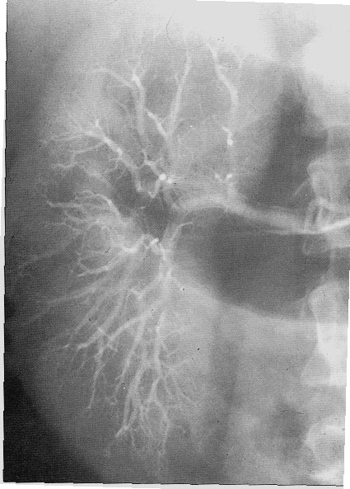
Polyarteritis Nodosa
General
  prototype of vasculitides
  prevalence
    M>F
    50-60 yrs
  hepatitis B antigen in 30%
  small and medium arteries, aneurysms

Slide 48
PAN
General
  tissues
    GI tract, hepatobiliary system, kidney, pancreas, skeletal muscles
  complaints
    non-specific multisystem (malaise, weight loss, anorexia, fever)
  signs
    progressive arthritis, myopathy, neuropathy, hepatic and renal failure, GI bleeding

Slide 49
Churg-Strauss Syndrome
allergic angiitis and granulomatosis
General
  resembles PAN
  triad of systemic vasculitis, asthma eosinophilia
  nasal symptoms prominent
  unlike PAN-lungs always involved
  malaise, night sweats, fever, weight loss,
  peripheral eosinophilia up to 74%, ESR

Slide 50
Churg-Strauss Syndrome
Treatment
  Steroids

Slide 51
Wegener’s Granulomatosis
General
  necrotizing granulomas of upper airway, lower airway, kidney
  bilateral pneumonitis
  chonic sinusitis
  mucosal ulceration of nasopharynx
  renal disease
  hallmark pathologic lesion
    necrotizing granulomatous vasculitis

Slide 52
Wegener’s Granulomatosis
  antineutrophil cytoplasmic antibody (c-ANCA)
    sensitivity 65-90%

Slide 53
Wegerner’s Granulomatosis
Treatment
  meticulous dental and nasal care
  middle ear drainage
  cyclophosphamide 2 mg/kg plus prednisone 1 mg/kg

Slide 54
Giant Cell Arteritis
General
  temporal arteritis
    form of giant cell
    only extracranial vessels affected
  focal grannulomatous inflammation
    medium and small arteries
  most common vasculitis
  prevalence
    increases with age

Slide 55
Giant Cell Arteritis
  symptoms
    headache(constant, boring)
  ESR usually > 50 mm/hr
  confirmation temporal artery biopsy
  Skip Leasions

Slide 56
Giant Cell Arteritis
  temporal artery tender, erythematous
  scalp tender
  jaw claudication
  lingual claudication

Slide 57
Giant Cell Arteritis
Treatment
  prednisone
  normalization of ESR and symptoms
  up to two years

Slide 58
Polymyalgia Rheumatica
accompanying syndrome in 50% GC arteritis
clinical syndrome
  muscular pain
  morning stiffness proximal muscles
  increased ESR
  no inflammatory joint or muscle disease
  low grade fever, weight loss, malaise

Slide 59
Polymyalgia Rheumatica
treatment
  low dose prednisone

Slide 60
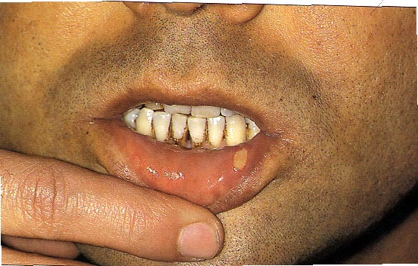
Behcet’s Disease
Vasculitis with triad
  oral, genital ulcers, uveitis or iritis
  oral
    aphthous-like
    painful, clusters on lips, gingiva, buccal, tongue

Slide 61
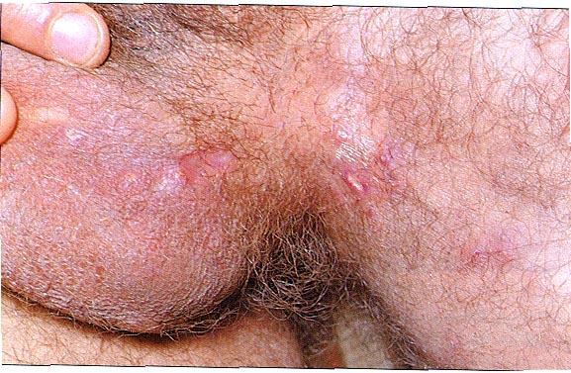
Behcet’s Disease
  genital
    similar in appearance

Slide 62
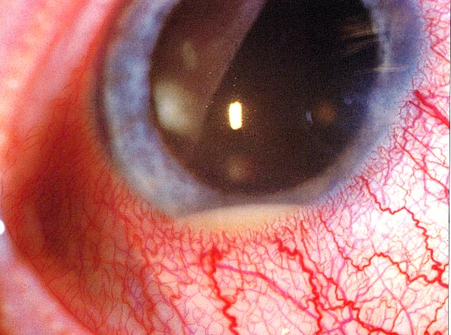
Behcet’s Disease
  occular
    uveitis, iritis
    hypopyon
  healing in days to weeks some scarring

Slide 63
Behcet’s Disease
treatment
  azothioprine, methotrexate

Slide 64
Kawasaki
General
  AKA mucocutaneous lymph node syndrome
  pediatric age group

